Slide 1
Main header for your presentation
Subtitle
Name Position Lab Group e.g. De Strooper Lab

Slide 2

Instructions for using the UK DRI template
We have created a UK DRI Powerpoint template for internal and external presentations, complete with UK DRI brand colours and associated affiliations. If you have any questions, please contact
UK DRI Communications Officer, Alex Collcutt, on Slack.
Guidance
To insert a new slide, click the dropdown next to ‘New slide’ in the ‘Home’ toolbar (see image on the right). You can choose from a title slide, normal text/image on white or black, blank slides on white or black (e.g. for full slide image/video) or an end slide for contact information and acknowledgements.
When copying and pasting a slide from another presentation, ensure the slide above is the same as your desired format, otherwise your content may copy onto an inappropriate format e.g. ‘title slide’ .
Font size suggestions are provided on the next slide. Ensure your fonts are no smaller than 16. If you are presenting in a bigger venue or with a smaller screen, consider increasing the font size further.

Slide 3
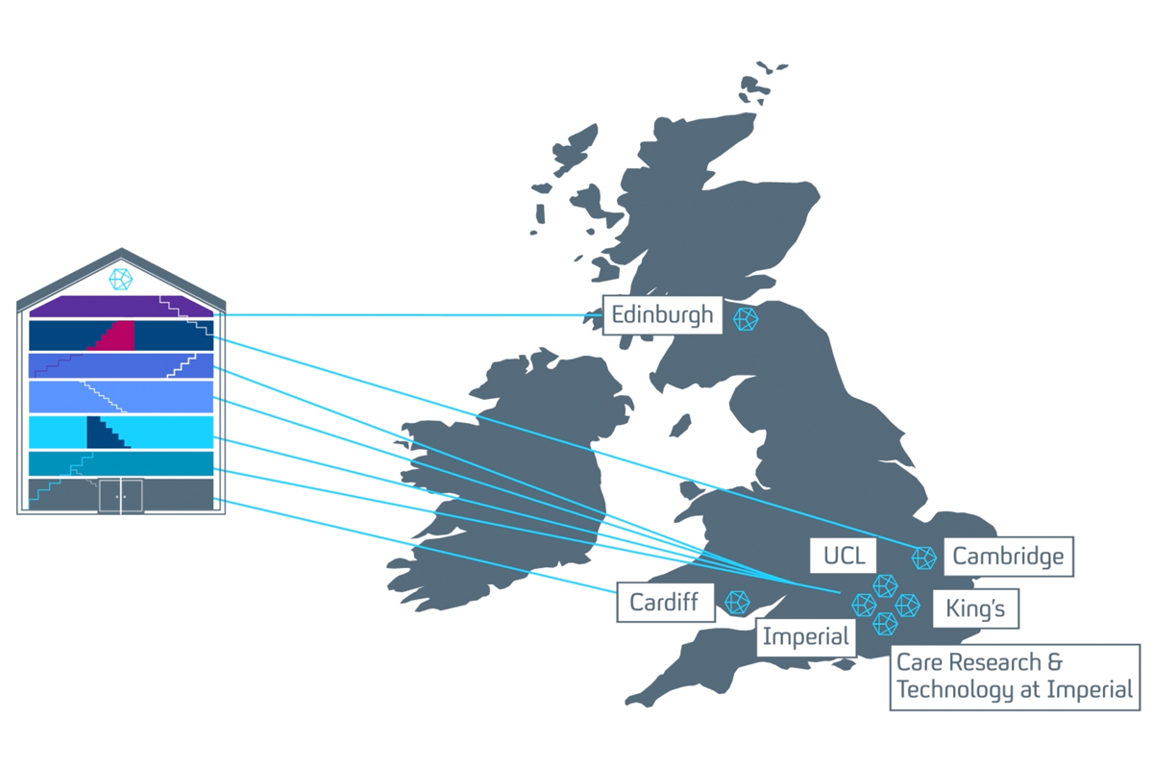
Main header / Question / Conclusion (Arial – 30 – navy)
Short example sentences which can be highlighted in bold or highlight colours. (Arial – 18 – navy)
Sample bullet point title (Arial – 18 – navy)
Bullet points are ‘sky blue’ and this can be customised under ‘Bullet points and numbering’
Sample bullet point 2 (Arial– 16 – navy)
Sample bullet point 1 (Arial – 16 – navy)

Slide 4

Main header / Question / Conclusion (Arial– 30 – navy)
Short example sentences which can be highlighted in bold or highlight colours. (Arial – 18 – navy)
Sample bullet point title (Arial – 18 – white)
Bullet points are ‘sky blue’ and this can be customised under ‘Bullet points and numbering’
Sample bullet point 2 (Arial – 16 – navy)
Sample bullet point 3 (Arial – 16 – navy)

Slide 5
Blank slide if required

Slide 6
Blank slide if required

Slide 7

Thank you for listening
Name Position Contact email or Slack details
Name Position / Role
Name Position / Role
Name Position / Role
Name Position / Role
Collaborator institution Name (Position / Role) Name (Position / Role) Name (Position / Role)
Collaborator project Name (Institution) Name (Institution Name (Institution

